Slide 1


Evaluation Proposal for the Canada Greener Homes Initiative
Prepared for:
CESEF Student Case Competition
June 19, 2023

Slide 2

LAND ACKNOWLEDGEMENT
We are gathered on the territory of the Huron-Wendat, signatories of the Traité Huron-Britannique de 1760.
As visitors to this place, we join the Wendat Nation in love and respect for the Land, our Eatenonha, who nurtures and sustains us all.
In reciprocity, we recognize and aim to uphold our responsibilities to care for the environment and for each other to advance climate action and reconciliation in our evaluation work and daily life.
Image Credit: Sahil Singh

Slide 3





MEET OUR TEAM
Tasha Lake
(she/her)
Maria Ramirez Prieto (she/her)
Karolina Kaminska
(she/her)
Laura Peach
(she/her)
Ying Zhu
(she/her)

Slide 4
PROPOSAL OUTLINE
Program Description
Evaluation Design
Logistics and Dissemination
Program Overview
Evaluation Goals
Program Partner Engagement
Logic Model
Approach
Methods & Analysis
Evaluation Matrix
Knowledge Sharing
Timeline
Challenges & Mitigation Strategies
CES Competencies

Slide 5
Canada Greener Homes Initiative Overview
Canada Greener Homes Initiative
NRcan
Canada Housing and Mortgage Corporation
Greener Homes Grant Program (CGHG)
Canada Greener Homes Loan Program (CGHL)
External Third Parties
End Users

Slide 6
INFORMED APPROACH
Relevance
Performance
Contributions to Climate Change Action

Slide 7



EVALUATION GOALS AND QUESTIONS
Evaluation Goals: To assess the relevance and performance of CGHI and to provide recommendations on how CGHI can better/further contribute to commitments to climate change action
Question 1. What is the relevance of CGHI to end users, the environment and Canada?
Question 2. ​ How well was the CGHI implemented in the first three years of implementation? ​
Question 3. ​ How does CGHI contribute to Canada's commitments to Climate Change Action? ​

Slide 8
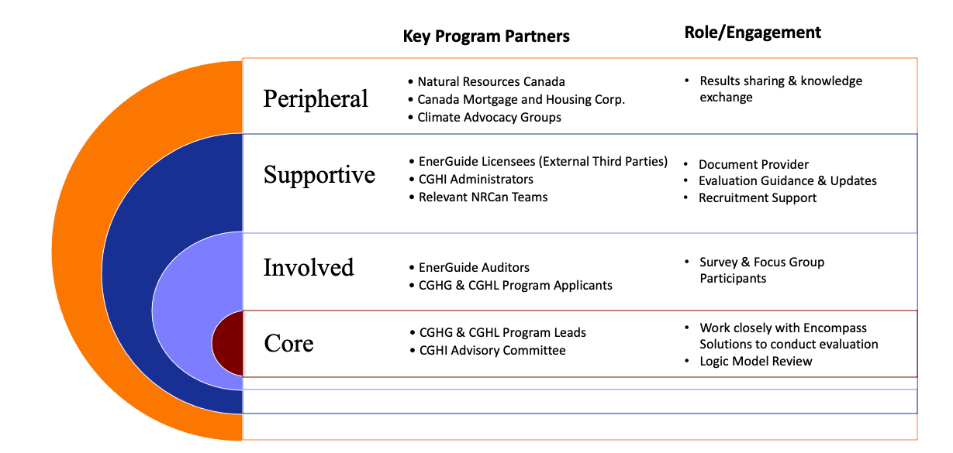
PROGRAM PARTNER ENGAGEMENT

Slide 9
LOGIC MODEL
INPUTS
ACTIVITIES
OUTPUTS
OUTCOMES
Staff
-NRCan Green Home Grant (CGHG) Program Staff
-CMHC’s Canada Greener Homes Loan (CFHL) Program Staff
Financial Resources
-$2.6 Billion (NRCan)
-$4.1 Billion (CMHC)
Materials
-Application forms
-EnerGuide home energy assessment
-Retrofitting Equipment
-Retrofitting Technology
Partners
-Provincial Program
-External Third Parties
-NRCan-licensed service organizations
- # of visits to the program website
- # of applications
- # of NRCan-licensed
service organizations
- # of EnerGuide energy
advisors/auditors
trained
-# of Energy Advisor/auditors
registered
- # of energy audits completed
SHORT TERM
INTERMEDIATE
LONG TERM
NRCan’s Greener Homes Grant
-EnerGuide energy auditor qualification
-Pre-retrofit EnerGuide home evaluation
-Post-retrofit EnerGuide home evaluation
Environmental
Improved energy efficiency and reduced greenhouse gas emissions in Canada’s homes to achieve the country's emissions reduction target of 40% below 2005 levels by 2030 and net-zero emissions by 2050
Capacity is available to meet demand for EnerGuide assessments
Increased skills and accreditation in the energy sector (EnerGuide energy Auditors and NRCan-licensed serviced organization)
Homeowners complete EnerGuide home energy assessments
- Average $ of grant requested/applicant
- Average $ of grant dispersed/applicant
- # of planned and completed retrofits
Total $ of funded retrofits
- Total $ Loan-to-Value approval/per applicant
- Total $ Loan-to-Value
at distribution/per applicant
End-user
awareness of the program
CMHC’s Canada Greener Homes Loan
Economic
-Increased demand for labour in the repair
construction sector
-Households save money on energy bills
End-user
apply to the program
Homes
are retrofitted
Assumptions, Risk Factors, External Factors

Slide 10




LOGIC MODEL
INPUTS
ACTIVITIES
OUTPUTS
Staff
-NRCan Green Home Grant Program Staff
-CMHC’s Canada Greener Homes Loan Program Staff
Financial Resources
-$2.6 Billion (NRCan)
-$4.1 Billion (CMHC)
Materials
-Application forms
-Audit forms
-Retrofitting Equipment
-Retrofitting Technology
Partners
-Provincial Programs
-External Third Parties
-NRCan-licensed service organizations
- # of visits to the program website
- # of applications
- # of NRCan-licensed service organizations
- # of EnerGuide energy auditors trained
- # of Energy Advisor/auditors registered
- # of energy audits completed
- Average $ of grant requested/applicant
- Average $ of grant dispersed/applicant
NRCan’s Greener Homes Grant
-EnerGuide energy auditor qualification
-Pre-retrofit EnerGuide home evaluation
-Post-retrofit EnerGuide home evaluation
- # of retrofits planned
- # of retrofits completed
Total $ of funded retrofits
CMHC’s Canada Greener Homes Loan
- Total $ Loan-to-Value approval/per applicant
- Total $ Loan-to-Value
at distribution/per applicant

Slide 11








LOGIC MODEL
OUTPUTS
OUTCOMES
- # of visits to the program website
- # of applications
# of NRCan-licensed service
organizations
# of EnerGuide energy auditors Ttained
- # of Energy Advisor/auditors registered
- # of energy audits completed
Average $ of grant
requested/applicant
Average $ of grant
dispersed/applicant
SHORT TERM
INTERMEDIATE
LONG TERM
Capacity is available to meet demand for EnerGuide assessments
Environmental
Improved energy efficiency and reduced greenhouse gas emissions in Canada’s homes to achieve the country's emissions reduction target of 40% below 2005 levels by 2030 and net-zero emissions by 2050
Increased skills
and accreditation in the energy sector
(EnerGuide energy Auditors and NRCan-licensed serviced organization)
C
Homeowners complete EnerGuide home energy assessments
- # of retrofits planned
- # of retrofits completed
Total $ of funded retrofits
End-user
awareness of the program
Homes
are retrofitted
Economic
-Increased demand for labour in the repair
construction sector
-Households save money on energy bills
- Total $ Loan-to-Value approval/per applicant
- Total $ Loan-to-Value
at distribution/per applicant
End-user
program application

Slide 12
LOGIC MODEL
Assumptions
Risk Factors
External Factors
-Retrofitting existing homes is one of the most effective ways to reduce greenhouse gas emissions / Program auditors will offer the most effective ways to reduce greenhouse gas emissions
-End-users will be incentivized enough to buy into the program
-End-users have the resources to qualify and navigate the program’s application and model
-Economic recession impacting household and organization budgets
-Program oversubscription
-Lack of funding beyond the allocated 7 years
-Lack of time, user-competency and financial resources to navigate the program application
-Lack of financial resources to qualify for the program
-Lack of time, financial resources and support to qualify as a EnerGuide energy auditor

Slide 13



EVALUATION DESIGN
Combined process + outcomes evaluation
  Assess the implementation, initial and projected outcomes
Theory-driven and utilization-focused approach
  Relevance: Work with program partners to understand and test the assumptions that make up the CGHI theory
  Performance: Enhance the utilization of the findings and process to inform decisions and strengthen performance
Integrated Reconciliation, Equity, Diversity and Inclusion (REDI) lens
  Employ a collaborative engagement process that attends to power inequities and actively includes a diversity of voices

Slide 14
METHODS
Equity, Diversity, and Inclusion Considerations
Advisory Committee
Key Informant Interviews
Survey
Data and Document Review
Focus Group
Program Relevance, Implementation, and
Contribution to Climate Change Action
Program Relevance and Implementation
Mixed Methods
Program Implementation
Program Relevance and Implementation

Slide 15

ANALYSIS
Quantitative Analysis
Leverage existing data analysis tools and program resources to co-analyze data and build sustainable and compliant practices.
Qualitative Analysis
Iterative thematic analysis by evaluation team and program resources to ensure consistency in interpretation.
Sense-Making Workshops
Ongoing engagement of Advisory Committee to ensure data quality and develop recommendations.

Slide 16
EVALUATION MATRIX
Dimension | Evaluation Question | Indicator | Data Source | Data Collection
Evaluation question 1: What is the relevance of the CGHI to end users, the environment and Canada?
Social | 1.1) To what degree are potential end-users aware of the CGHI? | Number of visits to the program's website by region | Web analytics | Web analytics
Social | 1.2) What sociodemographic groups are represented in the pool of applicants of the CGHI? | Number of applications submitted by: geographic location, age of applicant, gender identity, indigenous identity, racial identity | Applicant Portal | Administrative Data
Financial | 1.3) To which sociodemographic groups is the CGHI program considered affordable? | Total Debt Service Ratio by: geographic location, age of applicant, gender identity, indigenous identity, racial identity Perspectives of program affordability | Applicant Portal End users | Administrative Data Survey and Focus Groups
Environmental Canada | 1.4) ) What are end-users' perspectives on retrofitting existing homes and its effect on reducing greenhouse gas emissions? | Perspectives of whether retrofitting existing homes is one of the most effective ways to reduce greenhouse gas emissions | End users | Survey and Focus Groups

Slide 17
EVALUATION MATRIX
Dimension | Evaluation Question | Indicator | Data Source | Data Collection
Evaluation question 2: How well was the CGHI implemented in the first three years of implementation?
Financial Economic | 2.1) What is the extent to which funded activities have been fully implemented? | % of retrofits completed on time* % of retrofits completed on budget* Description of whether program activities were fully implemented as planned | NRCan and CMHC CGHG and CGHL program leads CGHI program administrators End users Energuide auditors | Administrative Data Document Review KIIs and scheduled meetings Survey Focus Groups
Economic | 2.2) What is the extent to which Energy Advisors have been successfully qualified? | % of Energy Advisors that are trained who registered | NRCan and CMHC | Administrative Data Document review
Social Financial Economic | 2.2) What are facilitators of effective implementation of the CGHI? | Facilitators to implementation | CGHG and CGHL program leads CGHI program administrators End users Energuide auditors | KIIs and scheduled meetings Survey Focus Groups
Social Financial Economic | 2.3) What are barriers to implementation of the CGHI? | Barriers to implementation | CGHG and CGHL program leads CGHI program administrators End users Energuide auditors | KIIs and scheduled meetings Survey Focus Groups
*Ex: "on budget" combines cost of retrofits planned vs. Cost of retrofits completed

Slide 18
EVALUATION MATRIX
Dimension | Evaluation Question | Indicator | Data Source | Data Collection
Evaluation question 3: How does CGHI contribute to Canada's commitments to Climate Change Action?
Social | 3.1) To what extent is there equitable representation of eligible households accessing the programs? | % of applicants who are accepted into the program % of users accepted into the program that complete work Sociodemographic info of users accepted into the program that have work completed in their homes/ organizations | Application Portal NRCan and CMHC | Administrative Data Document review
 | 3.2) What barriers exist for end-users from accessing all available services, including having work completed or receiving expected savings from the CGHI? | Barriers to accessing full extent of program, including having work completed and receiving expected savings | End users | Survey Focus Groups
Financial | 3.3) To what extent does the CGHI guide households towards energy bill savings? | Perspectives of end-users on whether advice provided by energy auditors will provide energy bill savings | End users | Survey Focus Groups
 | 3.4) To what extent does the CGHI contribute to improved energy efficiency in Canada's homes? | Average housing shelter cost reduction Average change in Energuide rating in households Estimated average annual money saved per year on energy bills by participating households | NRCan and CMHC | Administrative Data Document review
Economical | 3.5) To what extent does the CGHI contribute to increased capacity to meet demand for Energuide assessments? | Change in the number of advisors trained Change in the number of advisors accredited Change in the number of homes with completed Energuide assessments | NRCan and CMHC | Administrative Data Document review
Environmental | 3.5) What is the overall projected impact on greenhouse gas reduction? | Projected greenhouse gas (GHG) Reduction Petajoule (PJ) Savings from EnergGuide evaluation | NRCan and CMHC | Administrative Data Document review

Slide 19
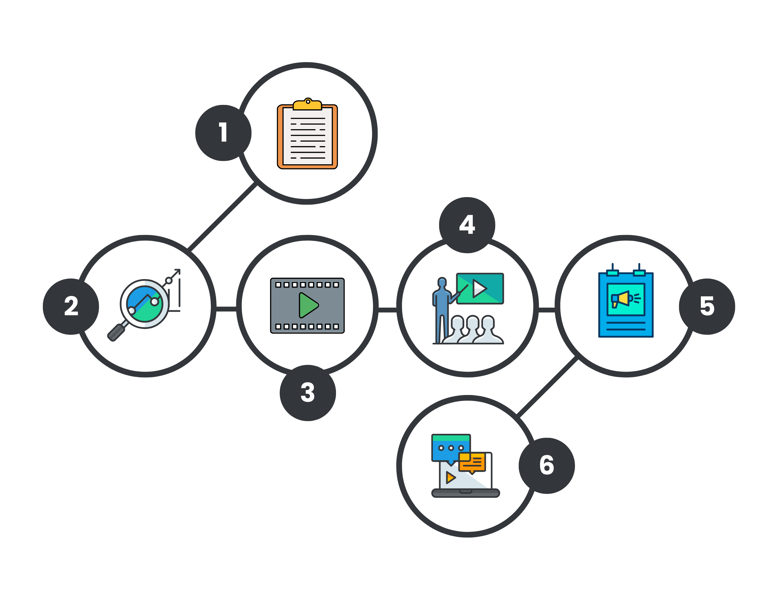
DISSEMINATION AND KNOWLEDGE SHARING
1) Report
Detailed finding, recommendations and action plans
4) In Person
Meeting and Events to share knowledge artifacts
2) Infographics
Key findings and recommendations
5) Physical Platforms
On Demand delivery of physical copies of knowledge artifacts
3) Multimedia
Key findings and recommendations
6) Virtual Platforms
Leverage digital tools to distribute knowledge artifacts

Slide 20
TIMELINE
Milestone/Months | 1 | 2 | 3 | 4 | 5 | 6 | 7 | 8 | 9 | 10 | 11 | 12
Assemble and engage the CGHI Advisory Committee
Finalize evaluation plan
Develop data collection, analysis, dissemination strategies and toolkit
Recruit participants and request data
Data collection
Data transcription, analysis, and sense-making
Advisory committee check-ins
Generate preliminary results and reports
Preliminary review and feedback
Finalize evaluation report and knowledge artifacts
Knowledge sharing and dissemination

Slide 21
CHALLENGES AND MITIGATION STRATEGIES
Recruitment, representation, and engagement of diverse program partners
Appropriateness of evaluation methods and potential low response rate
Project management risks and overall feasibility
Challenge
Collaborative engagement approach to communicate value of diverse perspectives
Diversity of data collection methods & maximization of existing tools and data
Develop clear roles and responsibilities during planning & conduct regular check-ins with Advisory Committee
Mitigation
High Risk
Medium Risk
Low Risk

Slide 22
CES EVALUATION COMPETENCIES
Domain | Competency | Meaning
Technical Practice | 2.9 Uses finding to answer evaluation questions and, where appropriate, to develop recommendations. | Important to address the goals and requirements of the evaluation outlines in the RFP. Demonstrated in the approach, evaluation methods and questions this evaluation asks.
Interpersonal Practice | 5.5 Builds partnerships within the evaluation context. | Important to build and maintain relationships within the cross organizational context of this evaluation. Demonstrated in the development of our CGHI Advisory committee

Slide 23



