Slide 1
1-800-SUMMITC
summitconsulting@gmail.com
17 Peak Pl., Summit City, CO 78664
EVALUATION PROPOSAL FOR
CANADA GREENER HOMES INITIATIVE
Prepared for: Canada Mortgage and Housing Corporation (CMHC) & Natural Resources Canada (NRCan)
June 19, 2023
Notes:
INTRO SLIDE (30 seconds) – 40 seconds (cut down one sentence)
Hello! Bonjour! On behalf of Summit Consulting, thank you for this opportunity! We are here today to present our comprehensive proposal for the evaluation of ___________ program.
We are confident we can deliver an innovative, yet feasible evaluation plan to provide you with actionable findings.
Bienvenu à tous, merci d’assister a notre presentation . Tout en reconnaissant l’importance de pouvoir travailler en francais et avec des gens ayant d'autres langues maternelles, notre presentation aujourd’hui sera en anglais.
We also recognize there were other languages spoken before settler arrival to Canada that have been erased.

Slide 2
LAND ACKNOWLEDGEMENT
Today, we recognize we have the privilege to be working on the Territory of the Nitassinan and Wendake-Nionwentsïo Peoples.
Recognizing colonization among First Nations, Inuit, and Métis Peoples is critical when evaluating Canada’s Greener Homes Initiative.

Slide 3
MEET THE TEAM
Sarah Sousa
(she/her)
Jiselle Bakker
(she/her)
Amanda Demmer
(she/her)
McKenna Szczepanowski
(she/her)
Thepikaa Varatharajan
(she/her)
Notes:
Now to introduce you to our fabulous team of consultants who have extensive experience conducting… community- based research and considering diversity within populations (modify this to align with the evaluation).
We have myself, McKenna, and to my left we have Thepikaa, Jiselle, Sarah and Amanda.
We want to emphasize this proposal is a living document as our team is committed to an iterative approach and we are really looking forward to collaborating with you .

Slide 4
1.0
Program Overview & Stakeholders
2.0
Logic Model
3.0
Evaluation Approach
OUTLINE
OF
PROPOSAL
4.0
Program Evaluation Matrix
5.0
Data Collection Methods & Analysis
6.0
Dissemination of Evaluation Findings
7.0
Timeline/Workplan
8.0
Anticipated Challenges & Mitigation Strategies
9.0
Canadian Evaluator Competencies
Notes:
We’ve presented the outline for our evaluation proposal for the ______ (program) and as a note you can follow along with the tabs at the top of each of the slides.

Slide 5
Program Overview & Stakeholders
Program Logic Model
Evaluation Design
Program Evaluation Matrix
Data Collection Methods & Analysis
Dissemination of Evaluation Findings
Timeline
Challenges, Mitigation Strategies & CES Competencies
PROGRAM OVERVIEW
Natural Resources Canada (NRCan)
Greener Homes Grant (CGHG) Program
CANADA
GREENER HOMES INITIATIVE
(CGHI)
Canadian Mortgage and Housing Corporation
(CMHC)
Canada Greener Homes Loan (CGHL) Program
*Program Differences may exist due to collaboration with provincial programs

Slide 6
Program Overview & Stakeholders
Program Logic Model
Evaluation Design
Program Evaluation Matrix
Data Collection Methods & Analysis
Dissemination of Evaluation Findings
Timeline
Challenges, Mitigation Strategies & CES Competencies
PROGRAM OVERVIEW
Canada Greener Homes Initiative
CGHG Program
CGHL Loan Program
Grants to homeowners for energy-efficient improvements (up to $5,000 per home)
Offers free EnerGuide energy assessments
Funds training for energy auditors
Assists with lowering capital costs for retrofit measures
2022: issued $69 million in grants
Personal loan amounts range from $5,000 to $40,000
Repayment over a 10-year period (no interest)
2022: >3,200 have applied for the loan

Slide 7
Program Overview & Stakeholders
Program Logic Model
Evaluation Design
Program Evaluation Matrix
Data Collection Methods & Analysis
Dissemination of Evaluation Findings
Timeline
Challenges, Mitigation Strategies & CES Competencies
PROGRAM STAKEHOLDERS
Primary
- Homeowners
- Indigenous governments
Organizations
Housing management bodies
Secondary
CGHI Staff (CGHG & CGHL)
EnerGuide Energy Auditors
CGHG & CGHL Executive committee members & Board of Directors
Tertiary
CMHC and NRCan
P/T Departments in Energy housing and environment
Contractors/Labourers

Slide 8
Program Overview & Stakeholders
Program Logic Model
Evaluation Design
Program Evaluation Matrix
Data Collection Methods & Analysis
Dissemination of Evaluation Findings
Timeline
Challenges, Mitigation Strategies & CES Competencies
EVALUATION PURPOSE AND SCOPE
MISSION/AIM
OUR EVALUATION PLAN
The aim of this evaluation is to assess the relevance and performance of Canada’s Greener Homes Initiative.
We plan to evaluate Canada’s Greener Homes Initiative through a process and outcome evaluation using an equity, diversity and inclusion lens with a utilization-focused approach and share results through national and P/T reports to all stakeholders involved.
MAIN OBJECTIVES
1. Assess how initiatives have been implemented in Canada.
2. Understand the effects of the program at the household, national and environment level.
3. Realize the contributions of the program to Canada’s commitment to climate change action and further recommendations.
Notes:
THIS IS WHAT THE PROGRAM IS DOING AND WANTS US TO EVALUATE
THESE ARE THE MAIN OBJECTIVES OF THE EVALUATION
THIS IS WHAT WE WILL DO (type of evaluation in order to do x, y, z, while maintaining an EDI/sustainability/Indigenous/GBA+ lens
EVALUATION PURPOSE & SCOPE (35 seconds)
The aim of this evaluation is to… (what does the RFP ask for?)
The main objectives are … (rephrasing the evaluation questions)
Based on this overview, we plan to… (type of evaluation in order to x,y,z, while maintaining an EDI/sustainability/Indigenous/GBA+ lens using this type of evaluation and approach)

Slide 9
Program Overview & Stakeholders
Program Logic Model
Evaluation Design
Program Evaluation Matrix
Data Collection Methods & Analysis
Dissemination of Evaluation Findings
Timeline
Challenges, Mitigation Strategies & CES Competencies
PROGRAM LOGIC MODEL
*Assumptions, Risks, and External Factors*
INPUTS
ACTIVITIES
OUTPUTS
OUTCOMES
What are we investing in the program?
What do we do in the program?
What are the results and changes?
SHORT TERM INTERMEDIATE LONG TERM
Canada Mortgage and Housing Corporation (CMHC)
Natural Resources Canada (NRCan)
Funding from CMHC and NRCan
Energy Auditors (EAs)
Training and evaluation programming for auditors
National and Regional (Western, Central, Atlantic, Territories) Advisory Committees
Eligible Households (Homeowners, Housing Management Bodies & Organizations, Indigenous Governments
Labourers
Building materials
CMHC Canada Greener Homes Loan
$5,000-$40,000 unsecured loan
# homeowners applying for loans
# of CMHC loans dispersed
(# loans by region (P/T))
Improved access to financial resources and supports to retrofit homes
Increase home energy efficiency
Increased number of homes that are retrofitted with energy efficient improvements nationwide
# jobs created for labourers/contractors
Reduced GHG emissions from home
# homeowners apply for NRCan grants
# of NRCan grants awarded
(# grants by region (P/T))
Increased capacity to meet demand for home assessments
NRCan Greener Homes Grant Program
Up to $5,000 per home in grants
Households save money on energy bills
ALL ACTIVITIES LEAD TO THIS:
Increased awareness of the importance and recommendations for retrofits moving forward.
Canada’s Greener Homes Initiative Integrated Online Portal
Used for both CMHC and NRCan program applications by Canadians
# pre-retrofit EnerGuide home evaluations
# homes retrofitted
# of different types of energy efficient improvements in homes
# homes with improved energy efficiency
# post-retrofit EnerGuide home evaluations
Barriers to accessing financial support are minimized
Achievement of country’s emission reduction target of 40% below 2005 level by 2030 and net-zero emission by 2050.
Increased demand for labourers in the repair construction sector
Awareness campaigns
Promo materials, ads, emails
Creation of local jobs in various communities
# Canadians accessing website
# Canadians requesting additional info
Increased number of EnerGuide EAs to conduct assessments
Training and registration of EnerGuide EAs
# EnerGuide EAs trained
If homeowners access sustainable funding programs offered by CMHC and NRCan
Homes will undergo energy assessments and be retrofitted for greater efficiency
THEN action will be taken towards improved energy efficiency, reduced GHG emissions and household savings on energy bills.
PROGRAM THEORY OF CHANGE:
Notes:
We have presented a logic model for you that systematically depicts our understanding of the PROGRAM NAME program and can be used for planning, monitoring, evaluation and as a communication tool.
We expect to have a review session with key stakeholders to capture the broad range of perspectives and ensure the model is harmonious with ORGANIZATION’s vision.
We have outlined a high level theory of change that indicates IF… THIS… THEN…

Slide 10
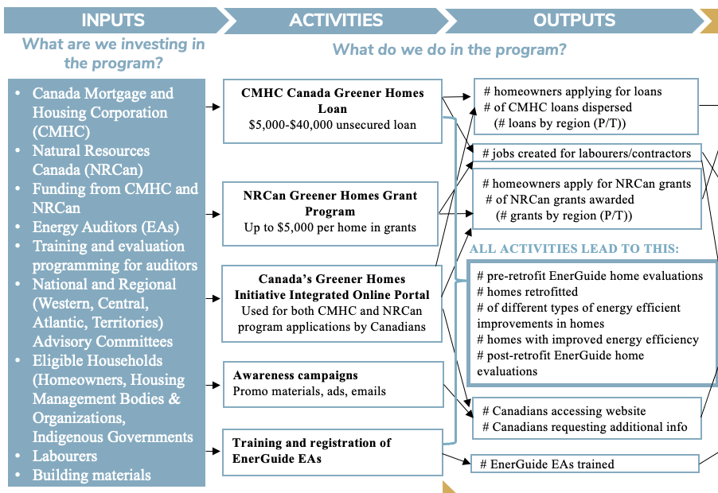
Program Overview & Stakeholders
Program Logic Model
Evaluation Design
Program Evaluation Matrix
Data Collection Methods & Analysis
Dissemination of Evaluation Findings
Timeline
Challenges, Mitigation Strategies & CES Competencies
PROGRAM LOGIC MODEL
*Assumptions, Risks, and External Factors*
PROGRAM THEORY OF CHANGE:
If homeowners access sustainable funding programs offered by CMHC and NRCan
Homes will undergo energy assessments and be retrofitted for greater efficiency
THEN action will be taken towards improved energy efficiency, reduced GHG emissions and household savings on energy bills.
Notes:
INPUTS, ACTIVITIES, OUTPUTS (45 seconds)
The logic model begins with outlining the inputs, which is what is being invested into the program.
The resources being invested include …
The activities that results from the resources invested include …
Then, the outputs here are measurable quantifiers that allows us to track the progress
Some of them include …

Slide 11
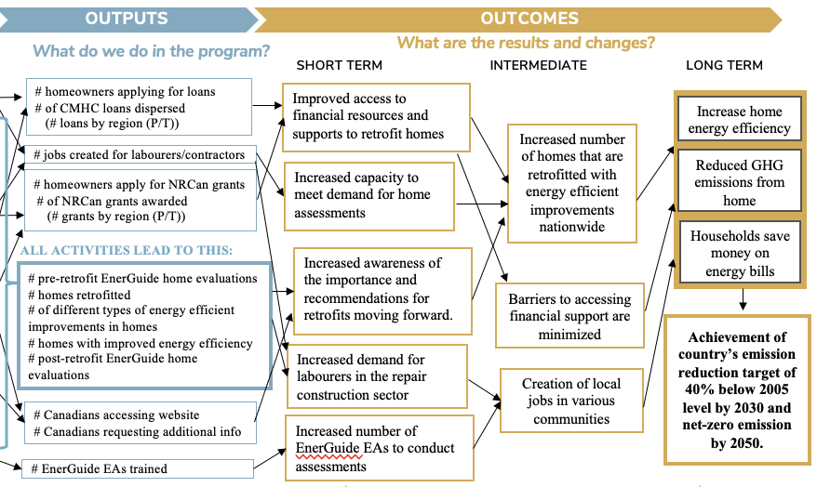
Program Overview & Stakeholders
Program Logic Model
Evaluation Design
Program Evaluation Matrix
Data Collection Methods & Analysis
Dissemination of Evaluation Findings
Timeline
Challenges, Mitigation Strategies & CES Competencies
PROGRAM LOGIC MODEL
*Assumptions, Risks, and External Factors*
PROGRAM THEORY OF CHANGE:
If homeowners access sustainable funding programs offered by CMHC and NRCan
Homes will undergo energy assessments and be retrofitted for greater efficiency
THEN action will be taken towards improved energy efficiency, reduced GHG emissions and household savings on energy bills.
Notes:
The inputs, activities and outputs previously discussed will ultimately lead to the realization of various outcomes.
Short term outcomes include …
Intermediate term outcomes include …
And the ultimate long term goal is to …

Slide 12
Program Overview & Stakeholders
Program Logic Model
Evaluation Design
Program Evaluation Matrix
Data Collection Methods & Analysis
Dissemination of Evaluation Findings
Timeline
Challenges, Mitigation Strategies & CES Competencies
PROGRAM LOGIC MODEL
RISKS
Potential for implementation to be inequitable or unjust
Potential for technical difficulties and coordination of the integrated online portal
ASSUMPTIONS
Eligible households are aware of the program and navigate the process
Knowledge change will lead to behaviour change (retrofitting will follow energy assessments)
Availability of energy auditors
EXTERNAL FACTORS
Historical context of colonization
Continued funding from CHMC and NRCan
Availability and pricing of building materials and labourers to carry out the retrofitting
Notes:
ASSUMPTIONS, RISKS, EXTERNAL FACTORS (30 seconds)
The proposed logic model is built on the assumptions that … for successful program implementation
Our team also sees potential risk given that …
One risk that has become apparent is that …
Subsequently, external factors which may influence the program's success include…

Slide 13
Program Overview & Stakeholders
Program Logic Model
Evaluation Design
Program Evaluation Matrix
Data Collection Methods & Analysis
Dissemination of Evaluation Findings
Timeline
Challenges, Mitigation Strategies & CES Competencies
EVALUATION DESIGN
EVALUATION METHODOLOGY
EVALUATION TYPE
EVALUATION APPROACH
Process and Outcome Evaluation
Utilization-Focused Approach
Diversity, Equity and Inclusion Lens
Notes:
In order to respond to the evaluation purpose (outlined in 1.3), we propose conducting a joint process and outcome evaluation of the Greener Homes Initiative to examine the fundamental design, its implementation and early outcomes of the two main programs at the end of the three-year implementation. A process evaluation describes the program and whether it was delivered as intended (WHO, 2000). An outcome evaluation measures near term effects of a program (Ontario Centre of Excellence for Child and Youth Mental Health, 2013).
To ensure that the findings of this evaluation are useful to the CGHI program leads, a utilization-focused approach is proposed (Patton, 2000) . Our process will ensure that we maximize the usability of the findings, through engaging our clients to clearly understand the needs, and ensuring our outputs will provide the information needed to support recommendations
Personally engaging primary intended evaluation users throughout the evaluation process is essential (Bryson et al., 2011; Patton, 2000).
Recognizing that Canadians and the people accessing these programs are diverse, including in income, ethnicity, language and their geographic location from urban to remote, a diversity, equity, and inclusion lens will be employed in this evaluation.
This approach will be embedded throughout, including in the construction of the evaluation questions, identification of priority populations for stakeholder engagement, identification of the methods (using a mixed methods approach in order to better understand the experience of program staff and users), analysis of the data (including disaggregating data where sample sizes permit, looking at themes), interpretation of the data, and sharing of the evaluation results and development of recommendations (Bellwether Education Partners, 2020; Hunt et al., 2022).
We will ensure that people traditionally marginalized or excluded are included in the evaluation and that systemic barriers to program implementation and outcomes are assessed (Bamberger & Segone, 2011; Government of Canada, 2011; Mertens, 2005).
Summit Evaluation will work with key stakeholders to be reflective of our social positions, power structures, and assumptions. We recognize that as an evaluation team we will have to take time to learn the context and history around for instance First Nations, Metis and Inuit communities and cultural approaches to housing and the impact on colonialism on housing, and to gather input to ensure our questions are appropriate. We will also work with our committees to develop a project positionality statement, that reflects the structures and the people engaged in this evaluation. For instance, we will explicitly acknowledge that this program and our evaluation focusses on the eligible groups for the program, and does not address unhoused individuals or tenants.
This evaluation will also consider intersectionality of the users???, in relation to their ability to participation and benefit from the project, as well as unintended impacts (Hankivsky, 2014). For more details on how we are applying a DEI approach, please reference the methods, challenges and mitigation strategies and the complete evaluation matrix.
To apply the utilization approach and the DEI lens, we are proposing that there be a national advisory committee, as well as regional advisory committees for this evaluation. We felt that because this is a Canada wide program, and that there are so many
The national committee would look broadly at the program at the national level and look at overall objectives.
The regional committees would ensure that regional specific considerations are included from an evaluation standpoint, and include representatives from CGHI grant and loans programs, and regional PT departmental representatives from contractors, immigrant, indigenous organizations.
To empower the Advisory Committee members to participate in the process, recognizing some would have limited evaluation experience (Patton, 2000), training would be provided, such as introductions of relevant terms and approaches.
recommend that the SMS-LTC Advisory Committee (hereafter referred to as Advisory Committee) be engaged in the evaluation, given the organizations present on this existing committee would be responsible for leadership in sustaining the initiative and implementing further phases of the SMS-LTC project. The Advisory Committee’s role will be to provide feedback on the evaluation plan, data collection processes and tools, interpretation and dissemination. Decisions will be informed by how they would affect the use of the evaluation, as per Patton (2000).

Slide 14
Program Overview & Stakeholders
Program Logic Model
Evaluation Design
Program Evaluation Matrix
Data Collection Methods & Analysis
Dissemination of Evaluation Findings
Timeline
Challenges, Mitigation Strategies & CES Competencies
ADVISORY COMMITTEES
NATIONAL
REGIONAL
Atlantic: Newfoundland, Prince Edward Island, Nova Scotia, New Brunswick
Central:
Ontario, Quebec
Prairies & West: Manitoba, Saskatchewan, Alberta, British Columbia
The North:
Yukon, Northwest Territories, Nunavut*
* Nunavut participation to be confirmed

Slide 15
Program Overview & Stakeholders
Program Logic Model
Evaluation Design
Program Evaluation Matrix
Data Collection Methods & Analysis
Dissemination of Evaluation Findings
Timeline
Challenges, Mitigation Strategies & CES Competencies
EVALUATION QUESTIONS
QUESTION #1: Implementation
To what extent have activities of the Canada’s Greener Homes Initiative been fully implemented?
QUESTION #2: Performance
What have been the effects of Canada’s Greener Homes Initiative for program users?
QUESTION #3: Impact
How can the Greener Homes Initiative contribute to Canada’s commitments to climate change action?

Slide 16
Program Overview & Stakeholders
Program Logic Model
Evaluation Design
Program Evaluation Matrix
Data Collection Methods & Analysis
Dissemination of Evaluation Findings
Timeline
Challenges, Mitigation Strategies & CES Competencies
PROGRAM EVALUATION MATRIX – Q1
Evaluation Question | Evidence/Indicator(s) | Method(s)/Tool(s) | Data Source(s)/Sample
Question #1: To what extent have programs of the Canada’s Greener Homes Initiative been fully implemented?
1.1 How effectively have programs been implemented by CMHC and NRCan? | # energy advisors trained # energy advisors registered # NRCan-licensed service organizations # visits to the program website # of funded retrofits (as proportion of # applicants) Types of retrofits planned/completed | Review of administrative data | CMHC & NRCan administrative data
1.2 How accessible are the programs for eligible groups? | # pre-retrofit energy audits completed # post-retrofit energy audits completed # applicants Value of grant requested/dispersed # loans dispersed # units with retrofits Cost of retrofits planned/completed Perceptions of accessibility by program users Perceptions of accessibility by eligible program non-users | Review of administrative data Focus groups / Talking circles Surveys | CMHC & NRCan administrative data Program users Eligible households who have not applied

Slide 17
Program Overview & Stakeholders
Program Logic Model
Evaluation Design
Program Evaluation Matrix
Data Collection Methods & Analysis
Dissemination of Evaluation Findings
Timeline
Challenges, Mitigation Strategies & CES Competencies
PROGRAM EVALUATION MATRIX – Q1
Evaluation Question | Evidence/Indicator(s) | Method(s)/Tool(s) | Data Source(s)/Sample
Question #1: To what extent have programs of the Canada’s Greener Homes Initiative been fully implemented?
1.3 What are the facilitators and barriers of effective implementation? | Perceptions of barriers & facilitators by program users Perceptions of barriers & facilitators by internal program stakeholders | Focus groups / Talking circles Key informant interviews | Program users CMHC & NRCAN staff, energy auditors
1.4 What variance exists in program uptake across sociodemographic variables? | Indicators of accessibility above, stratified by: Geographic data on location of applicant Age of dwelling Type of house Age of applicant Gender identify of applicant Indigenous identity of applicant Racial identity of applicant TDS Ratio of applicant Income level of applicant | Review of administrative data | CMHC & NRCan administrative data

Slide 18
Program Overview & Stakeholders
Program Logic Model
Evaluation Design
Program Evaluation Matrix
Data Collection Methods & Analysis
Dissemination of Evaluation Findings
Timeline
Challenges, Mitigation Strategies & CES Competencies
PROGRAM EVALUATION MATRIX – Q2
Evaluation Question | Evidence/Indicator(s) | Method(s)/Tool(s) | Data Source(s)/Sample
Question #2: What have been the effects of Canada’s Greener Homes Initiative for program users?
2.1 To what extent have the programs resulted in household savings? (environmental/financial) | PJ savings from EnerGuide evaluation Average annual savings on energy bills Average housing shelter cost reduction Perception of savings/program outcomes from program users | Review of administrative data Focus groups / Talking circles | CMHC & NRCan administrative data Program users
2.2 What other intended/unintended outcomes has the program had for program users? | Perceptions of program outcomes from program users | Focus groups / Talking circles | Program users

Slide 19
Program Overview & Stakeholders
Program Logic Model
Evaluation Design
Program Evaluation Matrix
Data Collection Methods & Analysis
Dissemination of Evaluation Findings
Timeline
Challenges, Mitigation Strategies & CES Competencies
PROGRAM EVALUATION MATRIX – Q2
Evaluation Question | Evidence/Indicator(s) | Method(s)/Tool(s) | Data Source(s)/Sample
Question #2: What have been the effects of Canada’s Greener Homes Initiative for program users?
2.3 What variance exists in program outcomes for households across sociodemographic variables? | Indicators of household outcomes above, stratified by: Geographic data on location of applicant Age of dwelling Type of house Age of applicant Gender identify of applicant Indigenous identity of applicant Racial identity of applicant TDS Ratio of applicant Income level of applicant | Review of administrative data | CMHC & NRCan administrative data

Slide 20
Program Overview & Stakeholders
Program Logic Model
Evaluation Design
Program Evaluation Matrix
Data Collection Methods & Analysis
Dissemination of Evaluation Findings
Timeline
Challenges, Mitigation Strategies & CES Competencies
PROGRAM EVALUATION MATRIX – Q3
Evaluation Question | Evidence/Indicator(s) | Method(s)/Tool(s) | Data Source(s)/Sample
Question #3: How can the Greener Homes Initiative contribute to Canada’s commitments to climate change action?
3.1 What is the projected contribution of the programs towards the 2023 goals at the current rate of uptake? | Projected GHG reduction | Review of administrative data | CMHC & NRCan administrative data
3.2 What program refinements are recommended to maximize program impacts for greenhouse gas reduction? | Analysis of indicators of implementation & outcome | Participatory data analysis | National & P/T advisory groups

Slide 21
Program Overview & Stakeholders
Program Logic Model
Evaluation Design
Program Evaluation Matrix
Data Collection Methods & Analysis
Dissemination of Evaluation Findings
Timeline
Challenges, Mitigation Strategies & CES Competencies
DATA COLLECTION METHODS
Online Focus Groups and
In-Person Talking Circles (TC)
Key Informant Interviews
Focus: Implementation Process (EQ1)
Group: Key Program Stakeholders
Focus: Implementation (Accessibility) (EQ1), Outcome (EQ2)
Group: Eligible Program Participants
Regional and P/T
Review of Administrative Data
Online Surveys
Focus: Implementation (EQ1), Outcome (EQ2), Impact (EQ3)
Group: Eligible Program Participants
Focus: Implementation (Accessibility) (EQ1)
Group: Eligible Program Non-participants

Slide 22
Program Overview & Stakeholders
Program Logic Model
Evaluation Design
Program Evaluation Matrix
Data Collection Methods & Analysis
Dissemination of Evaluation Findings
Timeline
Challenges, Mitigation Strategies & CES Competencies
DATA ANALYSIS
QUANTITATIVE ANALYSIS
Descriptive statistics
Stratified analysis by sociodemographic variables
Predictive modelling methods
QUALITATIVE ANALYSIS
Principles (all approaches):
Equity, Diversity, Inclusion will be considered to investigate variance/inequity
Recommendations will be co-created through participatory data interpretation with National & P/T advisory groups
Thematic content analysis
Consideration paid to themes of how sociodemographic factors moderate program experience
Notes:
*remember to highlight things that are EDI focus – visually or verbally*

Slide 23
Program Overview & Stakeholders
Program Logic Model
Evaluation Design
Program Evaluation Matrix
Data Collection Methods & Analysis
Dissemination of Evaluation Findings
Timeline
Challenges, Mitigation Strategies & CES Competencies
DISSEMINATION OF FINDINGS
LAUNCH EVENTS
National and P/T level
Review data & recommendations
CGHI discuss next steps
1:3:25 REPORTS
National and P/T level
1 page: Report cards
3 pages: Executive Summary
25 pages: detailed findings
Notes:
Knowledge mobilization plan ** → indicate what sort of approach this is
A variety of knowledge products will be developed and layered to promote accessibility and support use by different users (Rogers & Macfarlan, 2018).
We will have a report card of a synopsis of some key process and outcome indicators for each PT jurisdiction as well as national
There will also be more comprehensive final reports per jurisdiction, an executive summary (Canadian Health Services Research, 2001)
We will host a national launch event, followed by PT specific launch events

Slide 24
Program Overview & Stakeholders
Program Logic Model
Evaluation Design
Program Evaluation Matrix
Data Collection Methods & Analysis
Dissemination of Evaluation Findings
Timeline
Challenges, Mitigation Strategies & CES Competencies
TIMELINE / WORKPLAN
 | Q1 |  |  | Q2 |  |  | Q3 |  |  | Q4
Month | 1 | 2 | 3 | 4 | 5 | 6 | 7 | 8 | 9 | 10 | 11 | 12
Form Evaluation Advisory Committees
Create & Validate Logic Model
Identification of Existing Data Sources
Development of data collection tools
Recruitment
Data Collection
Data Analysis
Creating Final Reports & Knowledge Dissemination
Notes:
An overview of the proposed project timeline outlining anticipated activities is provided above.
We will begin with establishing committees
Validating our logic model, reviewing available data, developing
By Q3 we will be wrapping up our data collection and then
This timeline will be subject to change depending on advisory team availability and meeting feedback.
Dissemination of the key deliverables will occur immediately after finalization scheduled for _______________.

Slide 25
Program Overview & Stakeholders
Program Logic Model
Evaluation Design
Program Evaluation Matrix
Data Collection Methods & Analysis
Dissemination of Evaluation Findings
Timeline
Challenges, Mitigation Strategies & CES Competencies
CHALLENGES & MITIGATION STRATEGIES
1. Challenge #1 –Diversity in sample recruitment
2. Challenge #2 – Committee engagement
3. Challenge #3: Two programs/two entities
CHALLENGE
High Risk
Moderate Risk
Moderate Risk
Tailor recruitment material
Incentives
Monitor and report diversity metrics
Evaluate and refine recruitment strategies
Targeted agendas
Participant-centered communication & scheduling
Circulate information in advance
Training provided to committee members
Engage both program representative at committee level
Identify most important key indicators due to large data set
Teasing focus group data by program
MITIGATION
STRATEGY
Notes:
Identify preferred communication method (e-mail, phone)
For this evaluation, we anticipate some challenges and rated the level or risk for each challenge depending on the likelihood of the challenge occurring and its potential impact.
However, it should be noted that our risk assessment may change as we progress through the evaluation.
The first challenge is…..
We plan to address this issue by….
The second challenge is….
It will be addressed with…
The third challenge is…
Which we will address…
Centers for Disease Control and Prevention. Practical strategies for culturally competent evaluation. US Dept of Health and Human Services. 2014.

Slide 26
Program Overview & Stakeholders
Program Logic Model
Evaluation Design
Program Evaluation Matrix
Data Collection Methods & Analysis
Dissemination of Evaluation Findings
Timeline
Challenges, Mitigation Strategies & CES Competencies
CANADIAN EVALUATOR COMPETENCIES
Summit Consulting prioritizes the adherence to proper standards of practices, code of ethics, and evaluation competencies outlined in the Canadian Evaluation Society (CES) Competencies for Canadian Evaluation Practice
5.5 Builds partnership within the evaluation context
Essential to establish collaborative relationships with CMHC and NRCan to facilitate information sharing, data access, and cooperation
Establishing advisory committees and sharing evaluation findings and recommendations in a collaborative and constructive manner
Interpersonal Practice
2.6 Uses appropriate evaluation methods
Use available data from CMHC and NRCan
Our methods (e.g., focus groups, surveys) will allows us to produce useful, credible, and rigorous evidence to answer our evaluation questions.
Technical Practice
Notes:
Our team understands the importance of adhering to the CES Competencies.
One competency we plan on following is….
We have done this by:
Another competency we plan on following is:
We plan on doing this by…

Slide 27
THANK YOU
MERCI
Dr. Jennifer Yessis and Dr. Kelly Skinner (Coaches)
Dr. Scott Leatherdale (Mentor & Motivator)
Notes:
Before we go on to answering any questions, we wanted to thank CES for giving us the opportunity to present our proposal today, our coaches, Dr. Yessis and Skinner for all their support and guidance, and Dr. Leatherdale for his constant motivation.

